Slide 1
SPRING Building a basic REST API

Slide 2
REST API
Developing RESTful APIs is a task that most developers have faced at least once in their lives. Nowadays, with the increasing popularity of front-end frameworks like Angular, React, and Vue.js and with the mass adoption of smartphones, RESTful APIs became the most popular approach backend developers leverage to provide an interface for their applications.

Slide 3
Content
What is REST?
Java Example
Working with the Postman tool
Use of class “ResponseEntity<E>” and “Optional<E>”
GET, POST, PUT, DELETE
SwaggerUI automated documentation
Testscript in Postman tool

Slide 4
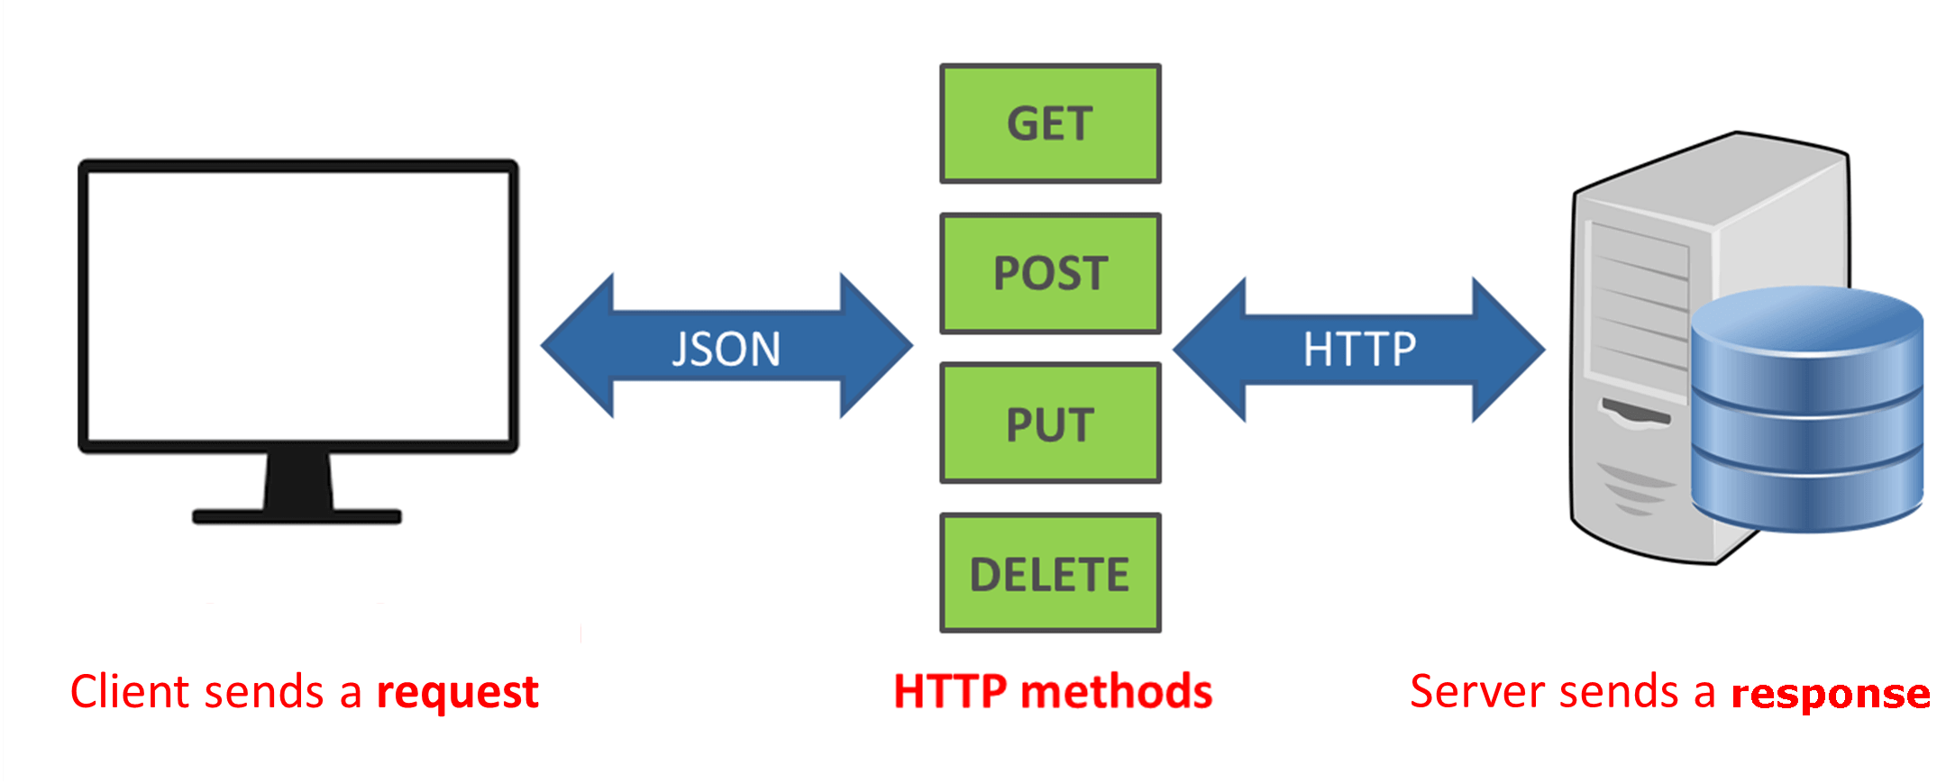
What is a REST API?
REST = Representational State Transfer
Something that allows one piece of software to talk to another piece of software over the HTTP protocol

Slide 5
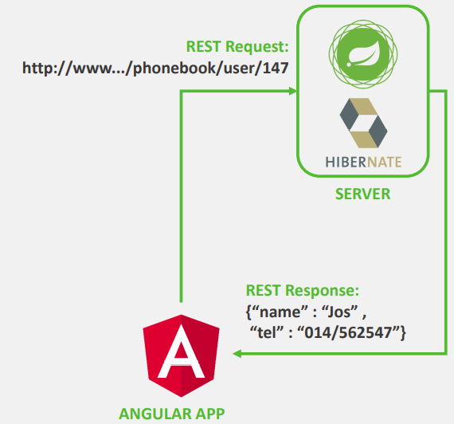
What is a REST API?
Platform-independent (iOS, Unix, Windows, ...)
Language-independent (C#, Java, PHP, ...)
Very common: REST-service built in Java Spring communicates with apps built in Angular, Reat, Vue, …
Uses HTTP for calls
HTTP Methods (GET, POST, PUT, ...)
Messages in JSON format:
Easy to use by JS, Typescript, Java, C# apps
Can in essence also be XML, CSV, ...

Slide 6
REST: COMMUNICATION BETWEEN CLIENT AND SERVER
REST requires that a client makes a request to the server in order to retrieve or modify data on the server. A request generally consists of:
an HTTP verb, which defines what kind of operation to perform
GET (retrieve a resource or collection of resources)
POST (create a new resource)
PUT (update a resource)
DELETE (remove a resource)
see also: https://www.codecademy.com/articles/what-is-crud
a header, which allows the client to pass along information about the request
In the header of the request, the client sends the type of content that it is able to receive from the server (= accept field). The options for types of content are MIME Types.
a path to a resource
In RESTful APIs, paths should be designed to help the client know what is going on. Conventionally, the first part of the path should be the plural form of the resource. This keeps nested paths simple to read and easy to understand.
A path like fashionboutique.com/customers/223/orders/12 is clear in what it points to, even if you’ve never seen this specific path before. We can see that we are accessing the order with id 12 for the customer with id 223.

Slide 7
Rest: SEPARATION OF CLIENT AND SERVER
In the REST architectural style, the implementation of the client and the implementation of the server can be done independently without each knowing about the other. This means that the code on the client side can be changed at any time without affecting the operation of the server, and the code on the server side can be changed without affecting the operation of the client.
As long as each side knows what format of messages to send to the other, they can be kept modular and separate. Separating the user interface concerns from the data storage concerns, we improve the flexibility of the interface across platforms and improve scalability by simplifying the server components. Additionally, the separation allows each component the ability to evolve independently.
By using a REST interface, different clients hit the same REST endpoints, perform the same actions, and receive the same responses.

Slide 8
Rest: stateless
Systems that follow the REST paradigm are stateless, meaning that the server does not need to know anything about what state the client is in and vice versa. In this way, both the server and the client can understand any message received, even without seeing previous messages. This constraint of statelessness is enforced through the use of resources, rather than commands. Resources are the nouns of the Web - they describe any object, document, or thing that you may need to store or send to other services.
These constraints help RESTful applications achieve reliability, quick performance, and scalability, as components that can be managed, updated, and reused without affecting the system as a whole, even during operation of the system.

Slide 9
Content
What is REST?
Java Example
Working with the Postman tool
Use of class “ResponseEntity<E>” and “Optional<E>”
GET, POST, PUT, DELETE
SwaggerUI automated documentation
Testscript in Postman tool

Slide 10


Java Example
Video : example of GET-requests
Video : example of POST-request

Slide 11
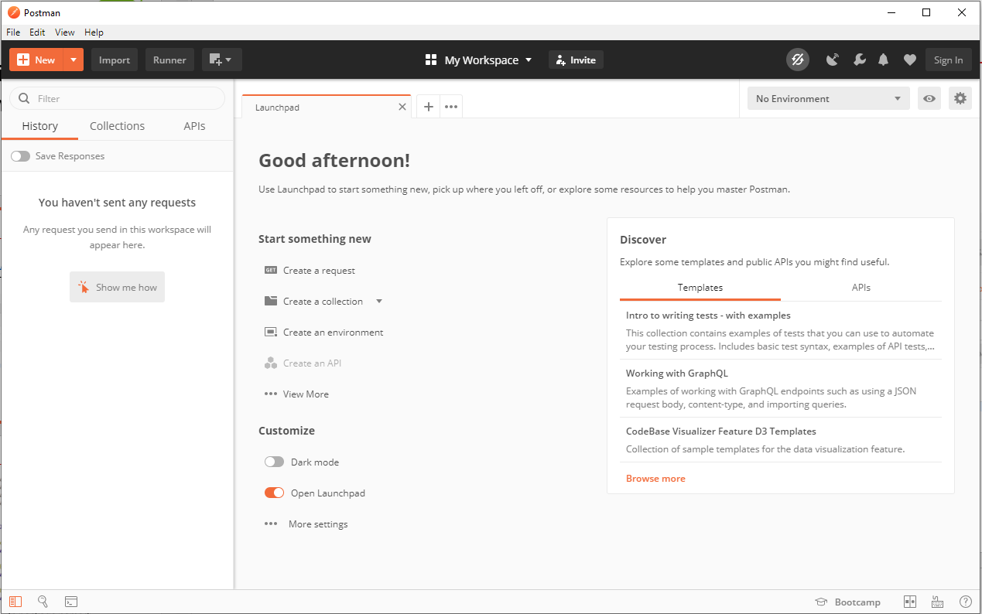
Creating our own API
In the following slides we will build a REST API as shown in the video’s with some differences and extensions…
Preparation:
Install Postman Tool that allows you to test REST APIs
Download: https://www.getpostman.com/apps
After install you can continue without signing in

Slide 12
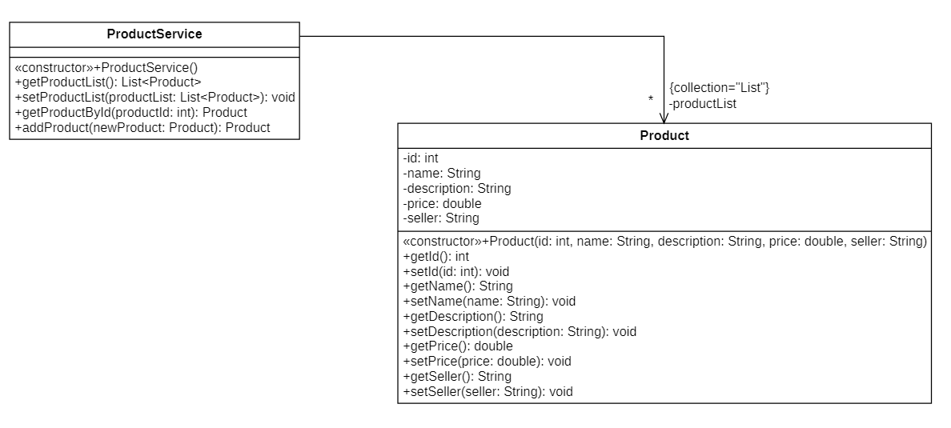
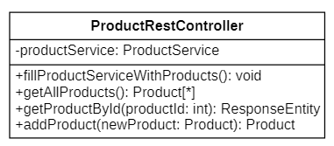
Data storage in the controller
We will not teach databases until next week; therefore, we simulate this by:
adding an “id” to the POJO-class “Product”
introducing a ProductService-class which can access every Product-object
adding an attribute of the ProductService-class to out RestController which will store the data
using @PostConstruct to a method in the RestController to fill the data our attribute with objects

Slide 13
Create the Class Product (in the package model)
public class Product { private int id; private String name, description; private double price; private String seller; public Product(int id, String name, String description, double price, String seller) { this.id = id; this.name = name; this.description = description; this.price = price; this.seller = seller; } //getters and setters of all attributes

Slide 14
Create the Class ProductService (in the package model)
public class ProductService { private List<Product> productList= new ArrayList<>(); public ProductService() { productList.add(new Product(1, "IPHONE", "This is an Awesome Iphone", 400.4, "Apple Inc")); productList.add(new Product(2, "Samsung", "This is an Awesome Samsung", 300.4, "Samsung Inc")); productList.add(new Product(3, "LG Z", "This is an Awesome LG", 200.4, "LG Inc")); } public List<Product> getProductList() { return productList; } public void setProductList(List<Product> productList) { this.productList = productList; }

Slide 15
RestController ProductRestController
@RestController is the annotation for creating Restful controllers. It is autodetected through classpath scanning. It converts the response to JSON or XML. It is typically used in combination with annotated handler methods based on the @RequestMapping annotation (@GetMapping, @PostMapping).
@RequestMapping(“/api”) is the annotation for adding “/api” to the path when sending requests to the RestController
@RestController @RequestMapping("/api") public class ProductRestController {

Slide 16
RestController ProductRestController
We make use of an attribute “productService” in the RestController to access data. Every method in the RestController can use this attribute to access the product-objects.
Calling the constructor of ProductService() will ensure that the attribute is instantiated and that the productList of the productService is filled with objects. We want this to happen from the very start of the application. We use the “@PostConstruct” annotation for that.
@RestController @RequestMapping("/api") public class ProductRestController { private ProductService productService; @PostConstruct public void fillProductServiceWithProducts() { productService = new ProductService(); }

Slide 17
@GetMapping @PostMapping @PutMapping @DeleteMapping
In the previous lesson every request from an HTML-page was handled by a method with an @RequestMapping annotation.
When building a REST controller we will have 4 different kinds of Request:
GET = used to retrieve data from the server. Multiple get requests to the same URL should be valid and no data should be changed on the server side.
POST = used when you need to create data on the server side. The enclosed entity should be considered as a new one that has to be added.
PUT = used when you want to change data on the server side. The enclosed entity should be considered as a modified version of the one residing on the origin server.
DELETE = used when you want to delete data on the server.

Slide 18
@GetMapping @PostMapping @PutMapping @DeleteMapping
The @RequestMapping annotation handles all types of incoming HTTP request including GET, POST, PUT etc. By default, it’s assumed all incoming requests to URLs are of the HTTP GET kind, and that was exactly what we needed in the previous lesson. Now we want to differentiate the mapping by HTTP request type. To do that we need to explicitly specify the HTTP request method.
We have some new annotations to do this:
@GetMapping (or alternative: @RequestMapping(method = RequestMethod.GET)
@PostMapping (or alternative: @RequestMapping(method = RequestMethod.POST)
@PutMapping (or alternative: @RequestMapping(method = RequestMethod.PUT)
@DeleteMapping (or alternative: @RequestMapping(method = RequestMethod.DELETE)
When building a REST service it’s very import to use these new annotations or to add a method parameter to the @RequestMapping annotation. If we don’t do that and stick to the old @RequestMapping without mentioning the method, we are only offering (the default) GET-functionalities in our REST service

Slide 19
Exposing APIs: GET /products
From here on we start adding code to expose the REST API
@GetMapping("/products") public List<Product> getAllProducts() { return productService.getProductList(); }
@GetMapping(“/products”)
Maps GET requests for this URL, to the method underneath the annotation.
the name of the path should be the plural form of the resource
(resource = product => path = /products)

Slide 20
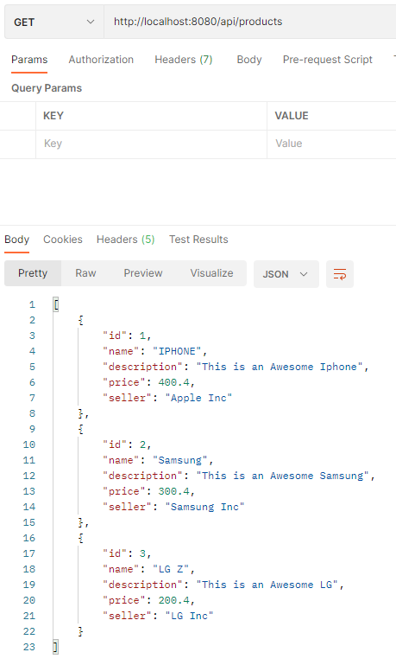
Exposing APIs: test GET /products
Now it’s time for testing our first REST API:
Run your application in IntelliJ
Start Postman and send a GET request to http://localhost:8080/api/products
You get the result back in JSON format

Slide 21
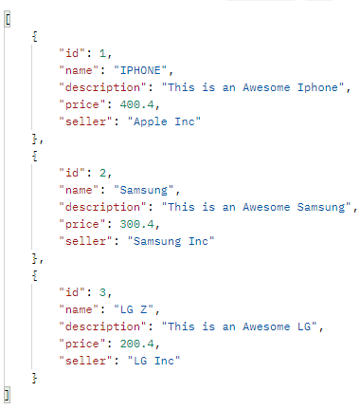
JSON
JSON format?
JavaScript Object Notation
a lightweight format for storing and transporting data
is often used when data is sent from a server to a web page
Standard for NoSQL databases like MongoDB
"self-describing" and easy to understand
JSON Syntax rules
Data is in name/value pairs e.g. “name”: ”IPHONE”
Curly braces {} hold objects (= with multiple name/value pairs)
Square brackets [] hold arrays
Data is separated by commas (between objects and between name/value pairs)

Slide 22
Exposing APIs: GET /product/{id}
A GET request to /product/{id} returns the product-object with the given id in the ArrayList
@PathVariable or @PathVariable(value = “id”)
Lets Spring know that the following is a variable from the URL
ResponseEntity<Product>
Allows you to modify the response with optional headers and status code.
@GetMapping("/product/{id}") public ResponseEntity<Product> getProductById(@PathVariable("id") int productId) {
Product product = productService.getOptionalProductById(productId);

Slide 23
Exposing APIs: GET /product/{id}
In ProductRestController:
In ProductService:
“findFirst()” returns an Optional<T> i.c. Optional<Product>
Optional is a container object used to contain objects that can be null or not-null. See next slides…
@GetMapping("/product/{id}") public ResponseEntity<Product> getProductById(@PathVariable("id") int productId) {
Optional<Product> product = productService.getOptionalProductById(productId);
public Optional<Product> getOptionalProductById(int productId){ return getProductList().stream().filter(p-> p.getId()==productId).findFirst();
}

Slide 24
Class Optional <T>
Every Java Programmer is familiar with NullPointerException. It can crash your code. And it is very hard to avoid it without using too many null checks.
To overcome this, Java has introduced a class Optional in java.util package.
a neat code without using too many null checks.
specify alternate values to return or alternate code to run.
=> makes code more readable

Slide 25
Class Optional <T>
This class may or may not contain a non-null value and has various methods to facilitate code to handle values as ‘available’ or ‘not available’ instead of checking null values:
if a value is present, isPresent() will return true
get() will return the value
orElse() will return the value if present and a default value if value is not present
@GetMapping("/product/{id}") public ResponseEntity<Product> getProductById(@PathVariable("id") int productId) { Optional<Product> product = productService.getOptionalProductById(productId); if (product.isPresent()) { return new ResponseEntity<>(product.get(), HttpStatus.OK); } return new ResponseEntity<>(HttpStatus.NOT_FOUND); }

Slide 26
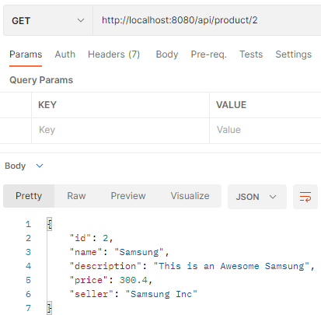
Exposing APIs: test GET /product/{id}
A get request to http://localhost:8080/api/product/2 gives us the second object in the productList

Slide 27
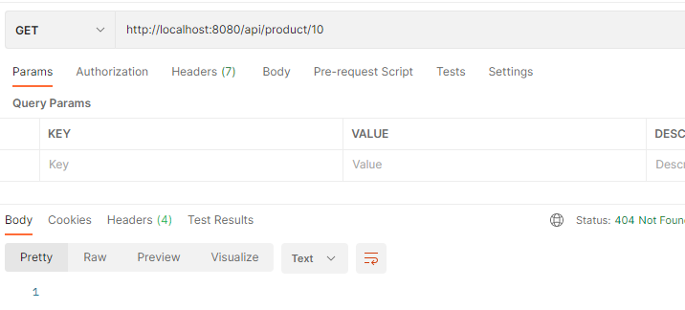
Exposing APIs: test GET /product/{id}
Get request of an non-existing id
no return and status = Not Found

Slide 28
Exposing APIs: POST /product/add
A POST request to /product/add adds the new product-object that is delivered with the request, and then returns the saved product-object for the user to view
@RequestBody
Says that the body of the incoming POST request is a Product object
With the incoming Product object we get all the information about the new Product. We just need to add an id. In this case we set the id to “size()+1” in the ArrayList. Later on, the database will generate an id for us.
@PostMapping("product/add") public Product addProduct(@RequestBody Product newProduct){ return productService.addProduct(newProduct); }
public Product addProduct(Product newProduct) { newProduct.setId(productList.size()+1); productList.add(newProduct); return productList.get(productList.size()-1); }

Slide 29
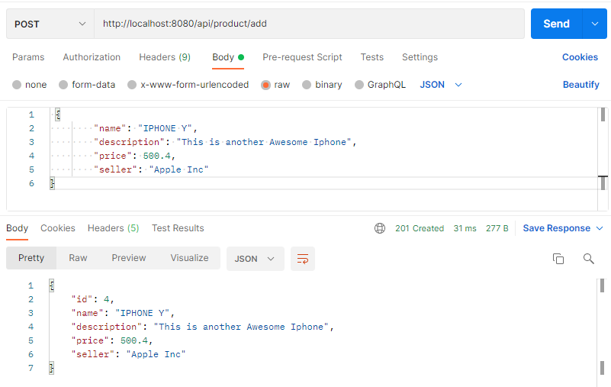
Exposing APIs: test POST /product/add
Request body
Return body

Slide 30
Exposing APIs: PUT /product/update/{id}
A PUT request to /product/update/{id} updates the product-object with the given id in the ArrayList, and returns the updated product for the user to view.
@PutMapping("product/update/{id}") public ResponseEntity<Product> updateProduct(@RequestBody Product updateProduct, @PathVariable("id") int productid){ Product product = productService.updateProductById(updateProduct, productid); if (product==null) { return new ResponseEntity<>(HttpStatus.NOT_FOUND); } return new ResponseEntity<>(product, HttpStatus.OK); }
public Product updateProductById(Product updateProduct, int productid) { Optional<Product> productOptional = getOptionalProductById(productid); if (productOptional.isPresent()){ Product product = productOptional.get(); product.setName(updateProduct.getName()); product.setDescription(updateProduct.getDescription()); product.setPrice(updateProduct.getPrice()); product.setSeller(updateProduct.getSeller()); return product; } return null; }

Slide 31
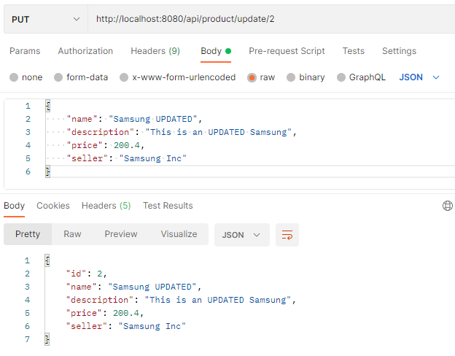
Exposing APIs: PUT /product/update/{id} test

Slide 32
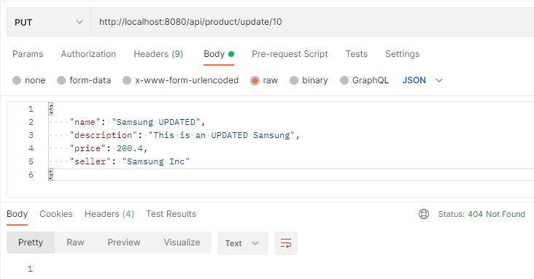
Exposing APIs: PUT /product/update/{id} test
Put request of an non-existing id
no return and status = Not Found

Slide 33
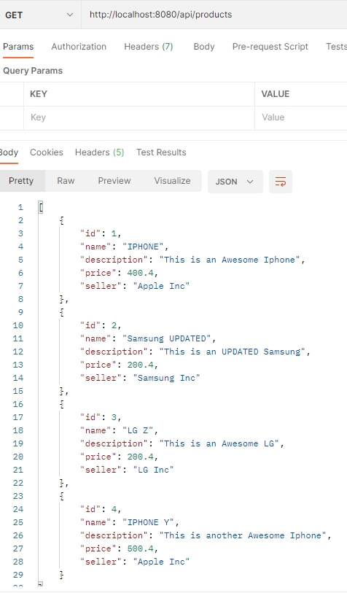
Exposing APIs: test GET /products
When we do a get request to retrieve all the elements of the list after the post and put request with the changed values we see the results.

Slide 34
Exposing APIs: DELETE /product/delete/{id}
A DELETE request to /product/delete/{id} deletes the product-object with the given id and returns the size of the productList and sets the http status to 200 (=OK). If the id is not in the productList this method will return a http 404-status (= Not Found)
@DeleteMapping("product/delete/{id}") public ResponseEntity<Integer> deleteProduct(@PathVariable("id") int productid){ Optional<Product> product = productService.getOptionalProductById(productid); if (product.isPresent()){ productService.getProductList().remove(product.get()); return new ResponseEntity<>(productService.getProductList().size(), HttpStatus.OK); } return new ResponseEntity<>(productService.getProductList().size(), HttpStatus.NOT_FOUND); }

Slide 35
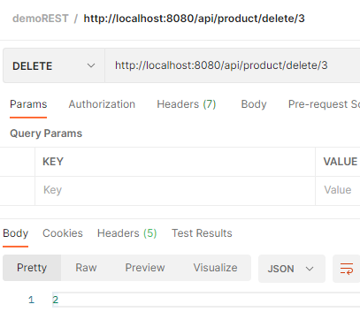
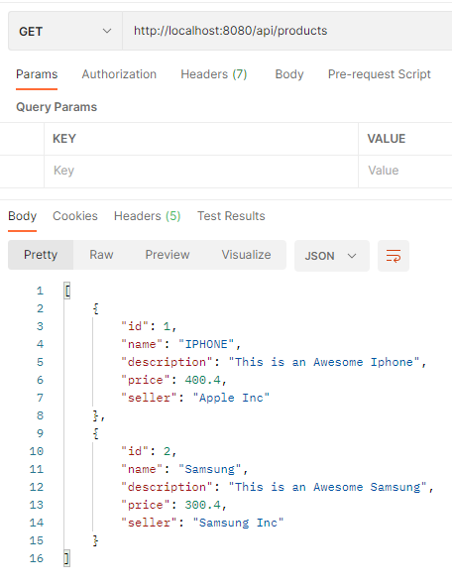
Exposing APIs: test DELETE /product/delete/{id}
Delete request of an existing id
size of productList = 2 => return of the method
Get request to check the result

Slide 36
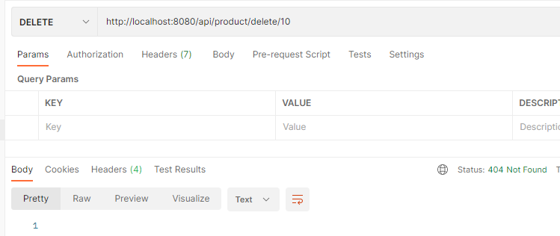
Exposing APIs: test DELETE /product/delete/{id}
Delete request of an non-existing id
no return and status = Not Found

Slide 37
Content
What is REST?
Java Example
Working with the Postman tool
Use of class “ResponseEntity<E>” and “Optional<E>”
GET, POST, PUT, DELETE
SwaggerUI automated documentation
Testscript in Postman tool

Slide 38
Generate documentation with Swagger
Now our REST web service is ready
We can use Swagger to automatically generate interactive API documentation
Swagger allows you to describe the structure of your APIs so that machines can read them. The ability of APIs to describe their own structure is the root of all awesomeness in Swagger. Why is it so great? Well, by reading your API’s structure, we can automatically build beautiful and interactive API documentation. We can also automatically generate client libraries for your API in many languages and explore other possibilities like automated testing. Swagger does this by asking your API to return a YAML or JSON that contains a detailed description of your entire API.

Slide 39
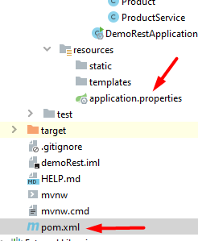
Documentation: SwaggerUI
To enable SwaggerUI:
Add this code in de application.properties-file:
import the two dependencies into pom.xml:
spring.mvc.pathmatch.matching-strategy= ant-path-matcher
<dependency> <groupId>io.springfox</groupId> <artifactId>springfox-swagger2</artifactId> <version>2.6.1</version> </dependency> <dependency> <groupId>io.springfox</groupId> <artifactId>springfox-swagger-ui</artifactId> <version>2.6.1</version> </dependency>

Slide 40

Documentation: SwaggerUI
import org.springframework.context.annotation.Configuration;
import com.google.common.base.Predicates;
import org.springframework.context.annotation.Bean;
import org.springframework.context.annotation.Configuration;
import springfox.documentation.builders.ApiInfoBuilder;
import springfox.documentation.builders.PathSelectors;
import springfox.documentation.builders.RequestHandlerSelectors;
import springfox.documentation.service.ApiInfo;
import springfox.documentation.spi.DocumentationType;
import springfox.documentation.spring.web.plugins.Docket;
import springfox.documentation.swagger2.annotations.EnableSwagger2;
@Configuration
@EnableSwagger2
public class SwaggerConfig {
@Bean
public Docket api(){
return new Docket(DocumentationType.SWAGGER_2)
.apiInfo(apiInfo())
.select()
.apis(RequestHandlerSelectors.any())
.paths(Predicates.not(PathSelectors.regex("/error.*")))
.build();
}
private ApiInfo apiInfo(){
return new ApiInfoBuilder()
.title("Products API")
.description("This page list all the rest apis for the products API.")
.version("1.0-SNAPSHOT")
.build();
}
}
Make a class SwaggerConfig in a new package named: config
This class gets the following contents, there will be a lot of imports to be done as well. You can also download this file, with the necessary imports, from Canvas.

Slide 41
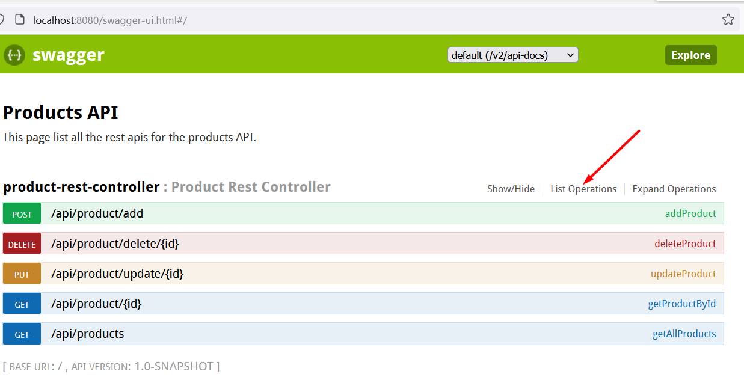
Documentation: SwaggerUI
Run and browse to: http://localhost:8080/swagger-ui.html

Slide 42
Content
What is REST?
Java Example
Working with the Postman tool
Use of class “ResponseEntity<E>” and “Optional<E>”
GET, POST, PUT, DELETE
SwaggerUI automated documentation
Testscript in Postman tool

Slide 43
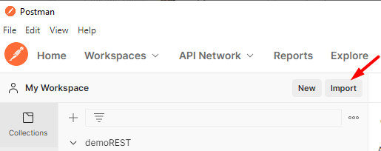
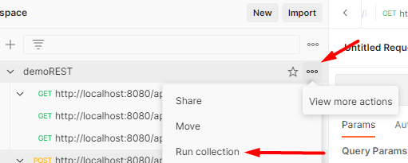

Run Testscript with Postman
Download “demoREST.postman_collection.json” and import the collection in Postman
(Re)Start your application and Run the imported collection:
Click

Slide 44
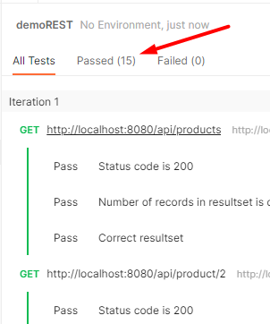
Result
hopefully…

Slide 45
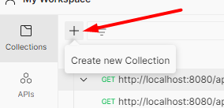
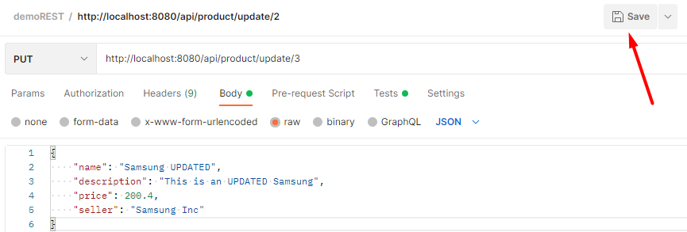
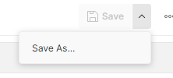
How to create your own testscript
Create a new collection
Save every http-request to this collection and add tests to every http-request.
If you enter a new request use “Save as”

Slide 46
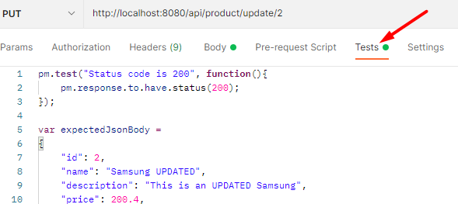
How to create your own testscript
Add tests to every http-request:
Tip: Use your correct(!) output to make these tests and look at the examples in the provided demoREST.postman_collection.json

Slide 47
What did we learn?
how to build a REST API in Spring Boot
how to avoid Exceptions using ResponseEntity and Optional:
in stead of catching errors, it is better to implement a design that makes it difficult for errors to happen. ResponseEntity and Optional help you to avoid errors.
how to generate documentation for this service
how to create your own testscript in Postman

